Slide 1

Introduction
TCS

Slide 2

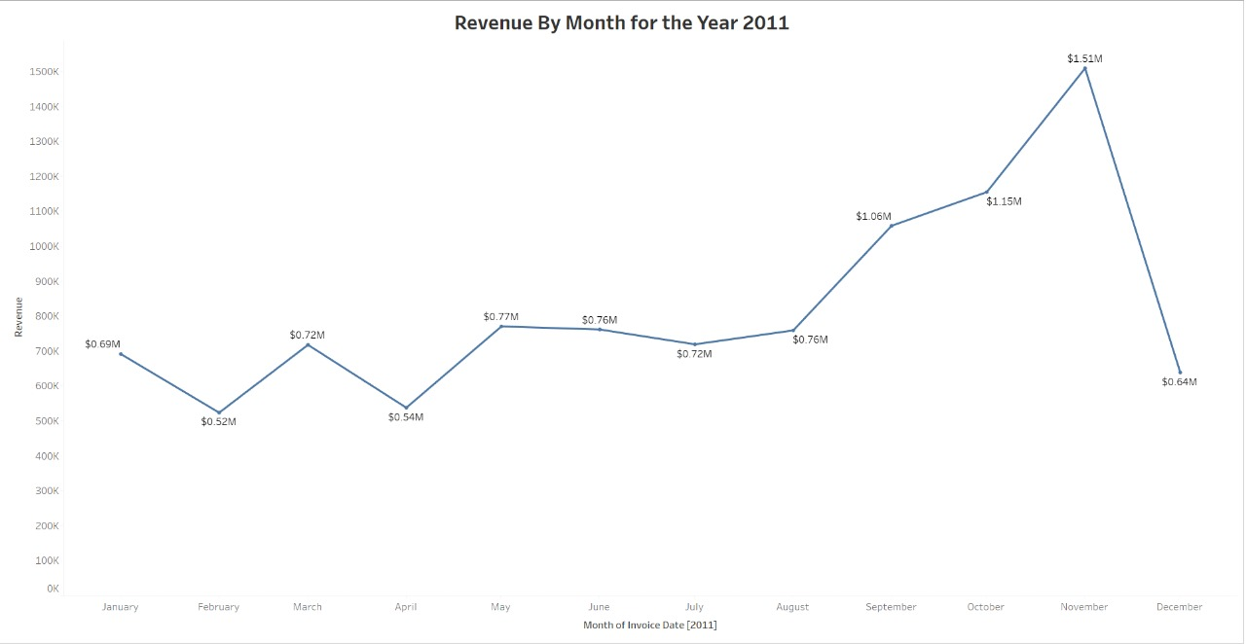
Revenue BY the month 2011
The first 8 months had stable monthly revenues with an average of $685,000.
We had a significant increase in revenue from September with the revenue peaking at $1.5 million in November & an average of 21.81%.
The Revenue trend from August to December demonstrates how seasonality affects retail store sales.

Slide 3
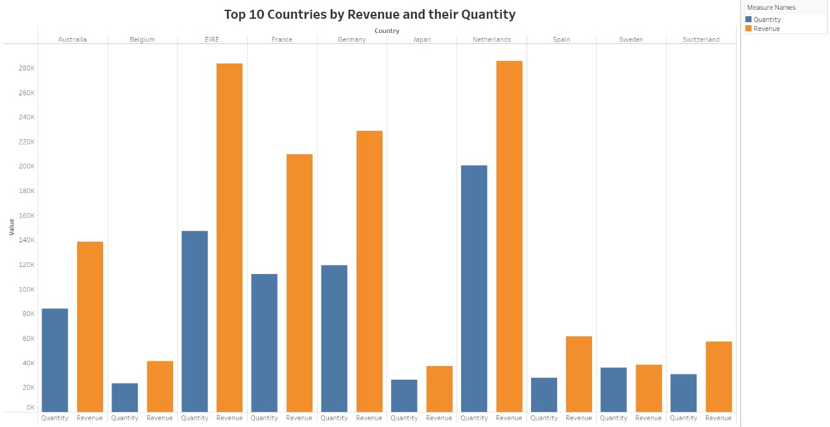
Top 10 country revenue & their quantity
This represents the top 10 countries in revenue and the quantities bought in these countries except the UK
There is no major difference between the revenue and quantity of goods sold in these countries showing high purchasing power in those countries.
These countries represent the region with the highest potential to generate more revenue that management needs to focus more on terms of marketing strategies.

Slide 4
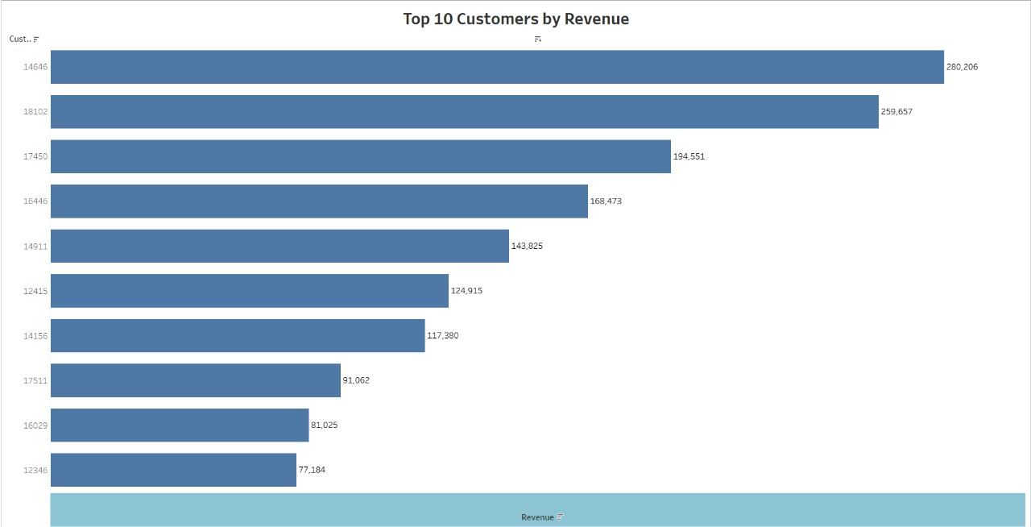
Top 10 customers by revenue
The chart shows that there is no major difference between the top 10 customers in terms of revenue generated.
The Average difference in revenue between the top 10 customers is 15.8%.
The Company aim to strengthen the relationship with these customers to customer loyalty and retention and ultimately drive more sales and revenue for the company.

Slide 5
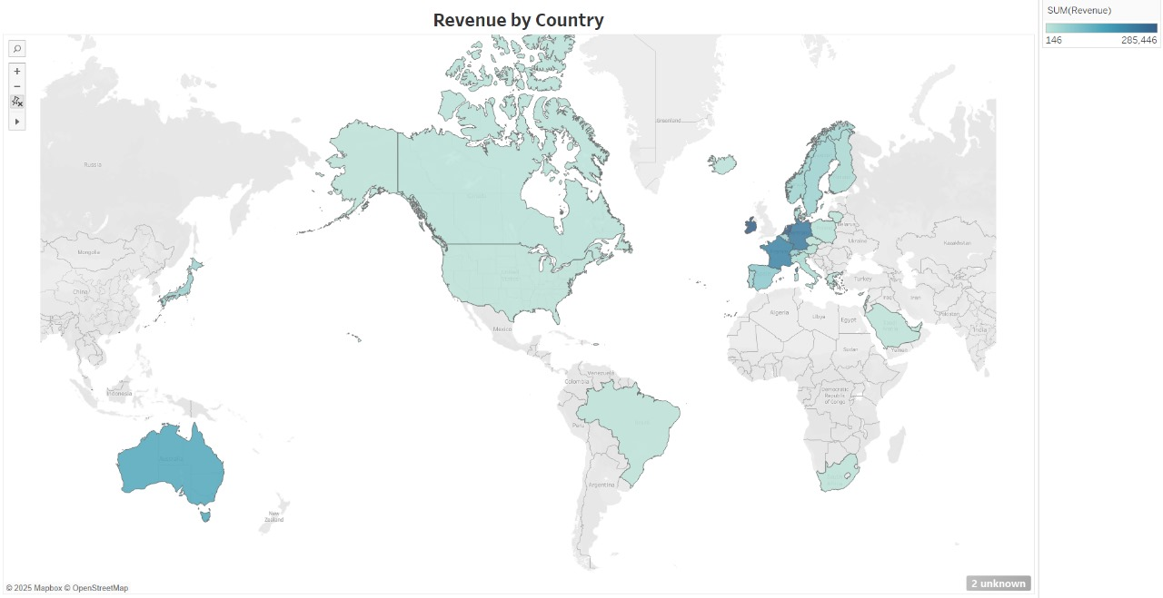
Revenue by country
Along with Russia there is no market for the items in Africa or Asia.
The map chart concludes by comparing the places that have produced the greatest revenue to those that have not.
The map also reveals that majority of sales occur only in the European zone with only a small number in the American region.
The company can be concentrated on the European market more end dive deeper into & countries in the region to come with strategies that will maximize sales from each country in the region alongside Australia and Japan.

Slide 6
Recommendations
The company should come with strategies that aim at stocking and advertising seasonal products to maximize sales when the demand for these goods goes up.
The company should do a deeper analysis of products that are usually in high demand during low-sales months to come with strategies for marketing these products.
A deeper dive into the type of products and the revenue generated from these products for each region would be key in guiding region-specific marketing strategies.
The company should consider incentivizing top revenue-generating customers to strengthen the relationship with these customers.
The European market has more potential for growth and the company should aim at strategies that will increase its market positioning in the region.

Slide 7

Thank you

